Slide 1
Factorization Machines
Authors: Steffen Rendle
Tiandi Ye
2020/09/09

Slide 2
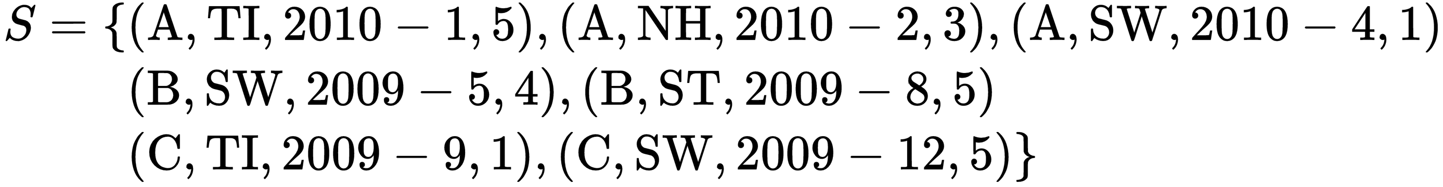
Movie Review System
$user u∈U, movie\left(item\right) i∈I, time t∈ℝ, rating r∈\left\{1, 2, 3, 4, 5\right\}$

Slide 3
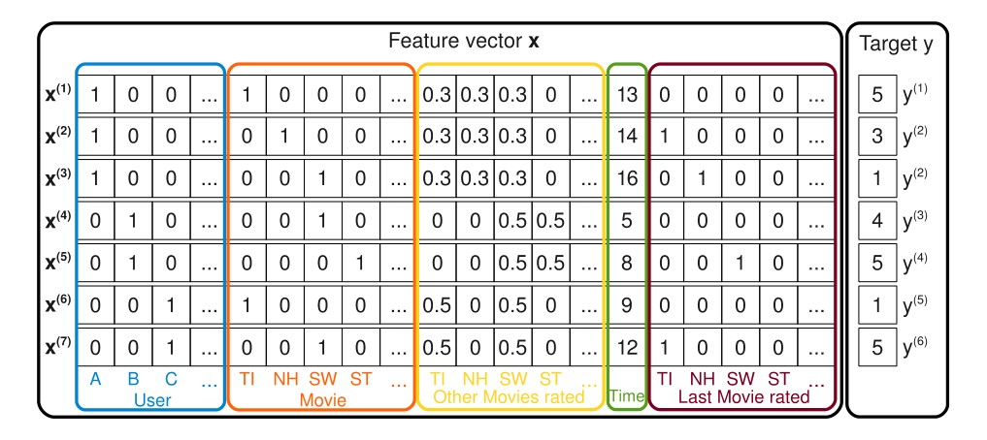
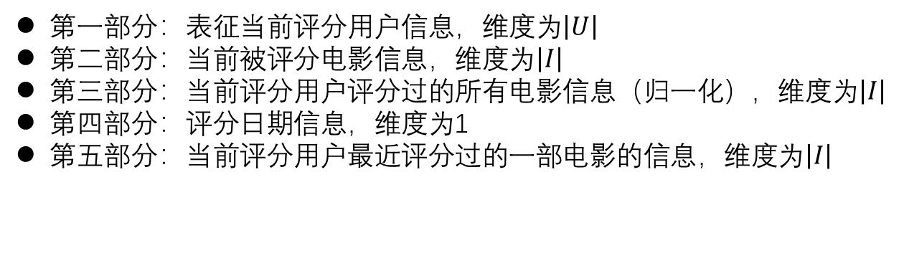
第一部分：表征当前评分用户信息，维度为$\left|U\right|$
第二部分：当前被评分电影信息，维度为$\left|I\right|$
第三部分：当前评分用户评分过的所有电影信息（归一化），维度为$\left|I\right|$
第四部分：评分日期信息，维度为1
第五部分：当前评分用户最近评分过的一部电影的信息，维度为$\left|I\right|$
特征向量总的维度：$\left|U\right|+\left|I\right|+\left|I\right|+1+\left|I\right|=\left|U\right|+3\left|I\right|+1$远大于每个用户参与评分的电影的数目

Slide 4
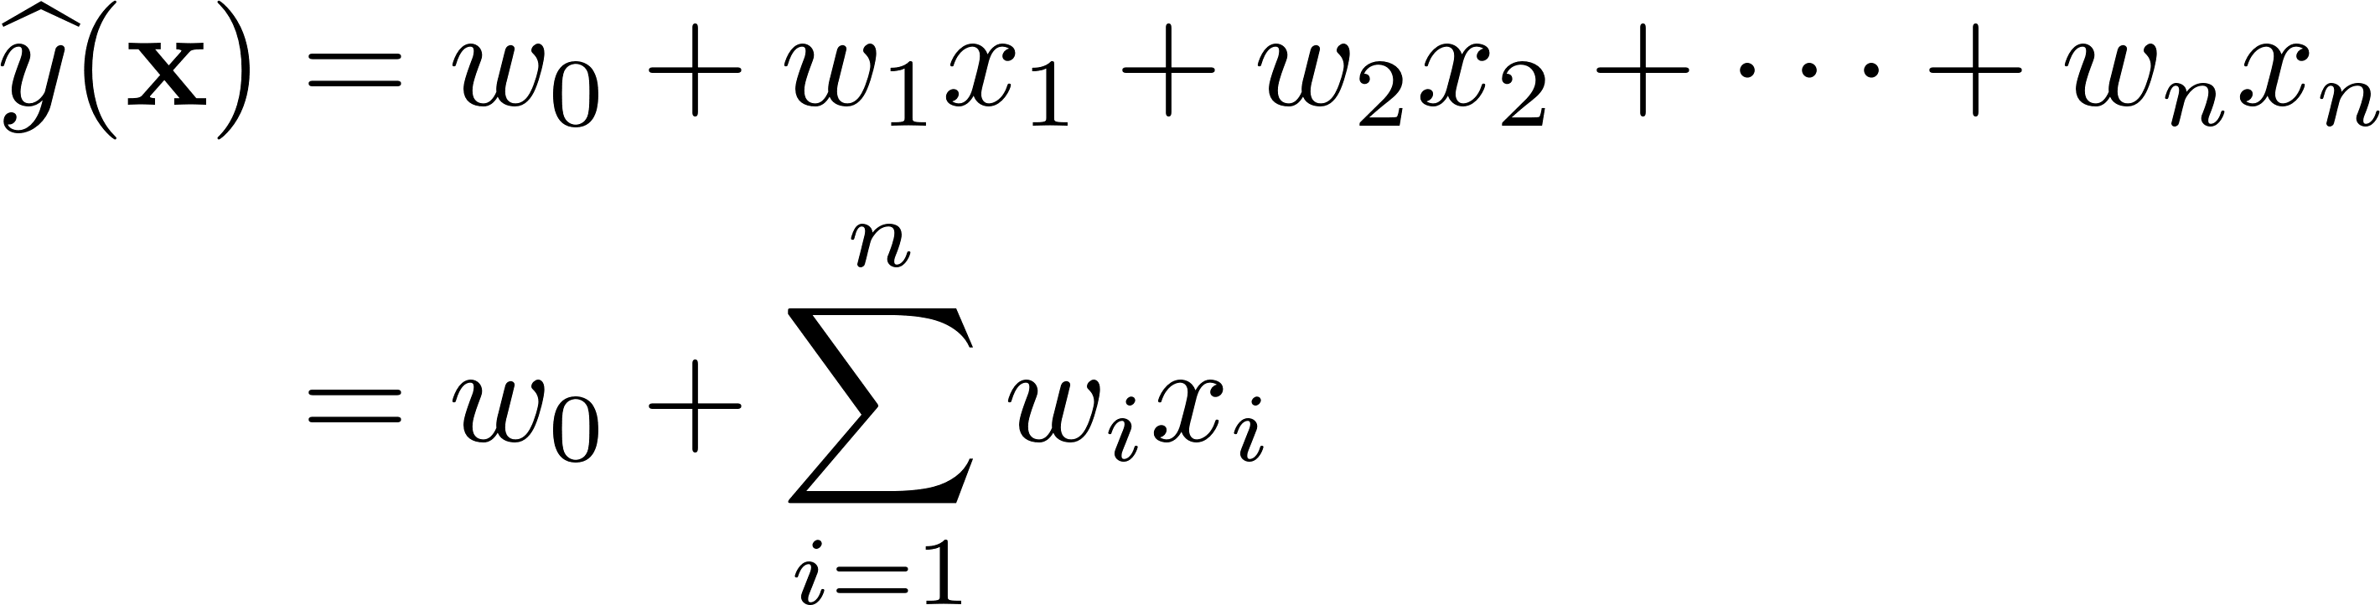
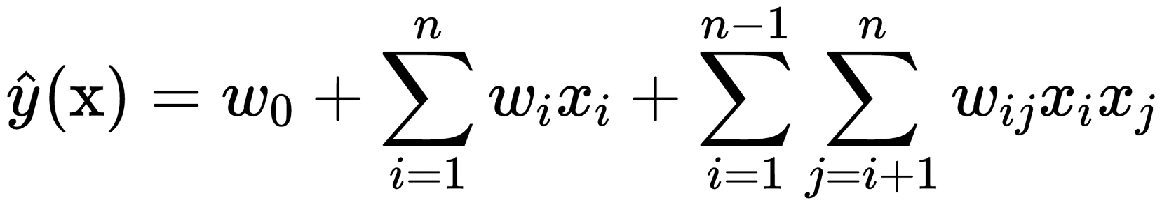
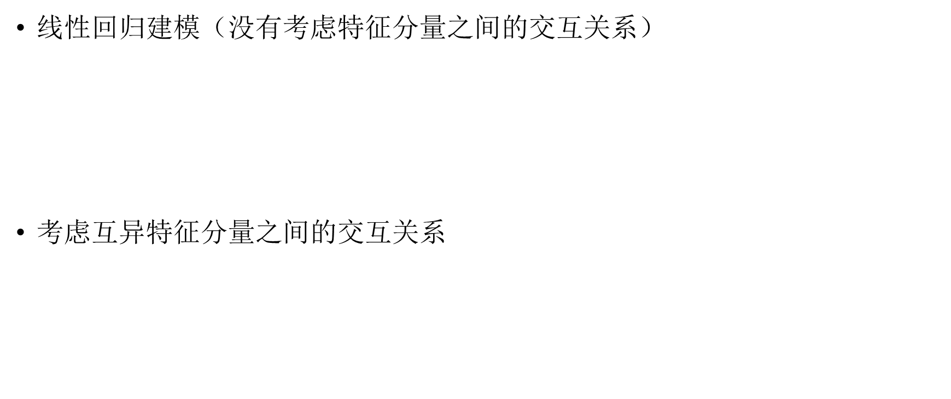
$线性回归$建模（没有考虑特征分量之间的交互关系）
$考虑$互异特征分量之间的交互关系
对于数据集中未出现过交互的特征分量，不能对相应的参数进行估计，在高度稀疏数据场景中，由于数据量不足，样本中出现未交互的特征分量是很普遍的

Slide 5
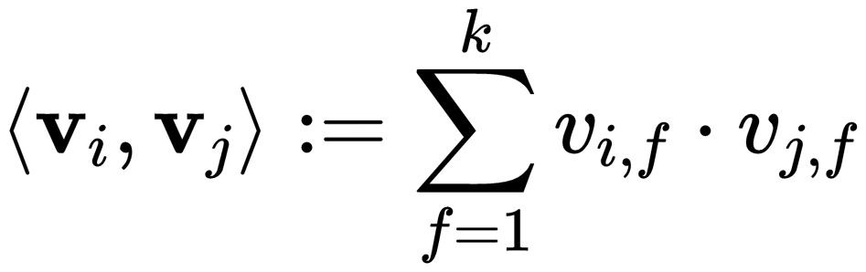
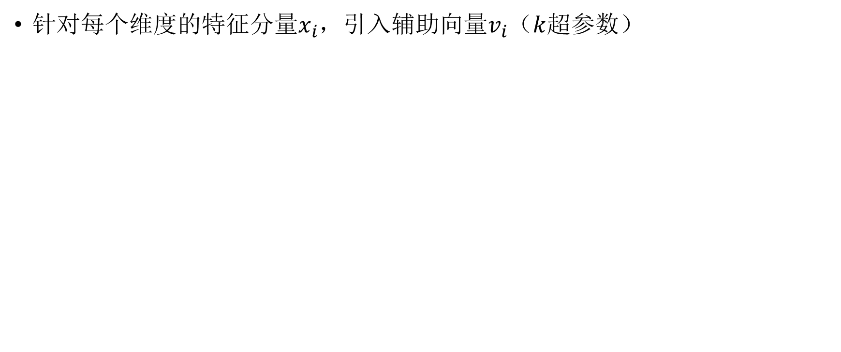
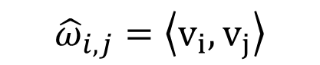
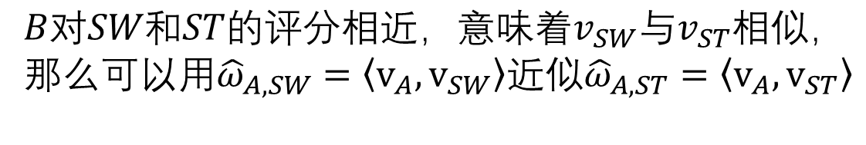
针对每个维度的特征分量$x_{i}$，引入辅助向量$v_{i}$（$k$超参数）
$${\hat{ω}}_{i,j}=\left\langle v_{i}, v_{j}\right\rangle$$
rating | TI | NH | SW | ST
A | 5 | 3 | 1
B |  |  | 4 | 5
C | 1 |  | 5
$${B对SW和ST的评分相近，意味着v}_{SW}与v_{ST}相似，$$
那么可以用${\hat{ω}}_{A,SW}=\left\langle v_{A}, v_{SW}\right\rangle 近似{\hat{ω}}_{A,ST}=\left\langle v_{A}, v_{ST}\right\rangle$

Slide 6
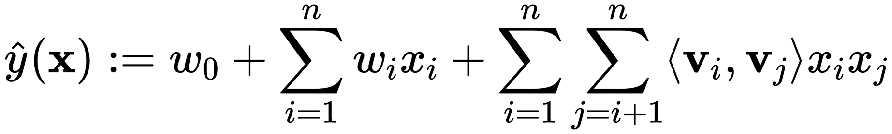
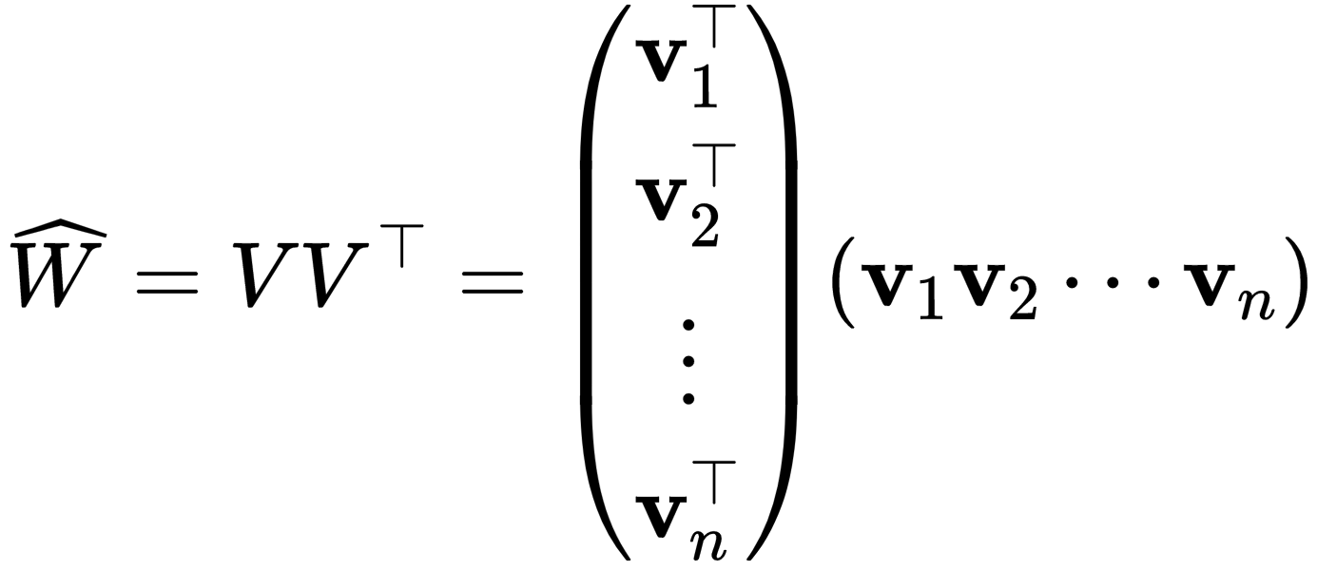
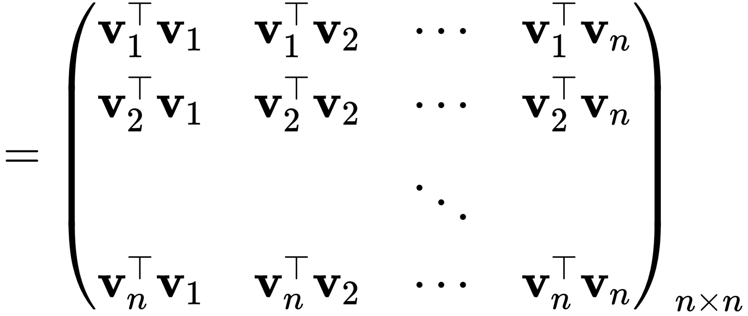
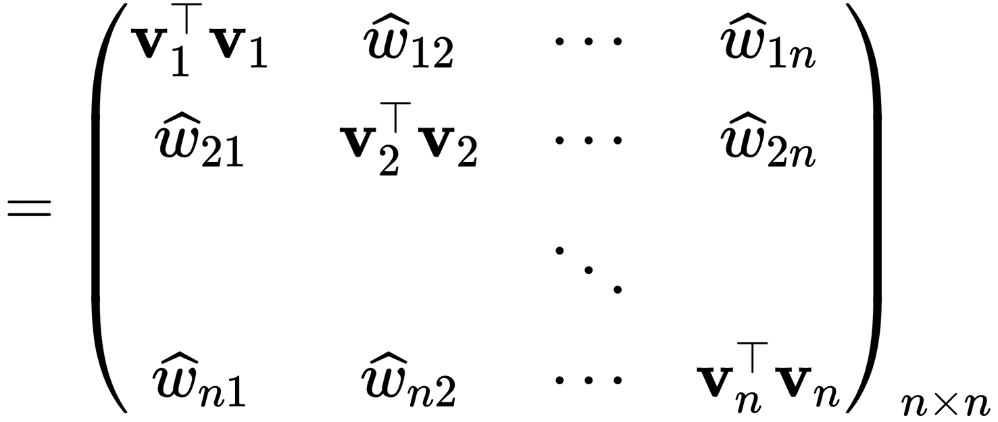
Model Equation
2-way二阶FM方程

Slide 7
Expressiveness
当$k$足够大时，对于任意正定矩阵$W$，均存在矩阵$V$，使得$W=V·V^{T}$
This shows that a FM can express any interaction matrix W if k is chosen large enough.
Restricting k – and thus the expressiveness of the FM – leads to better generalization and thus improved interaction matrices under sparsity.

Slide 8
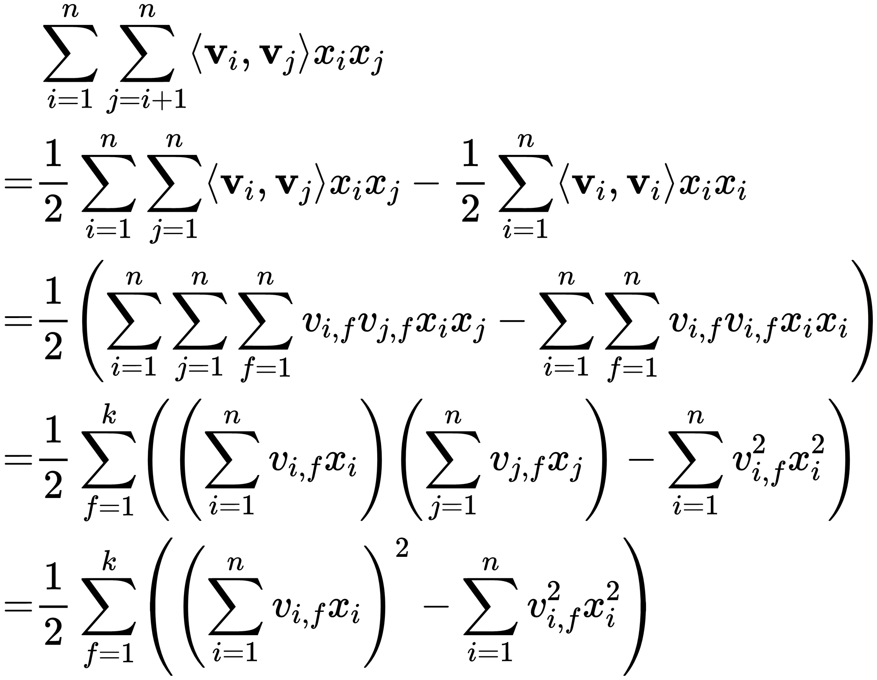
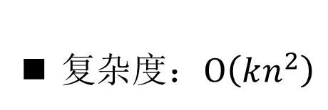
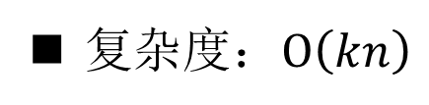
Computation
复杂度：$Ο\left(kn^{2}\right)$
复杂度：$Ο\left(kn\right)$

Slide 9
Factorization Machines as Predictors
FM can be applied to a variety of prediction tasks. Among them are:
Regression
Binary classification
Ranking

Slide 10
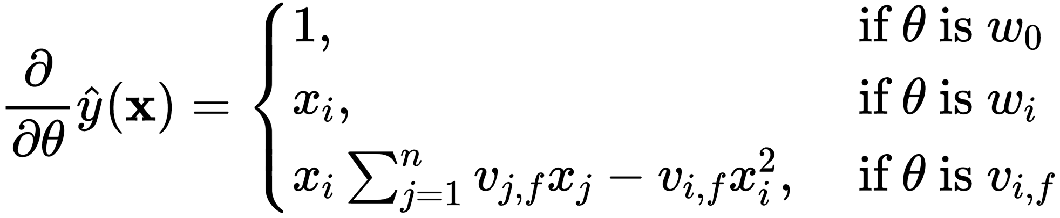
Learning Factorization Machines
Each gradient can be computed in constant time O(1)
All parameter updates for a case (x, y) can be done in O(kn)

Slide 11
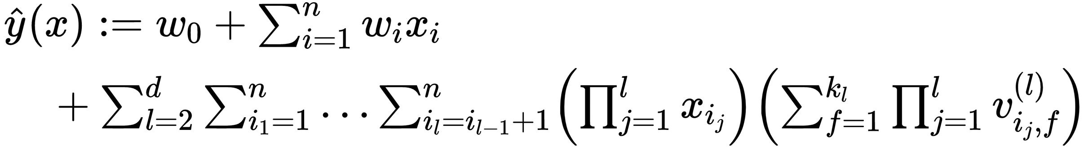
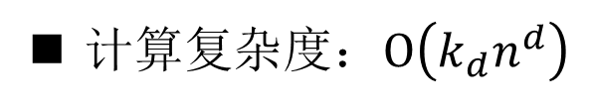
d-way Factorization Machine
计算复杂度：$Ο\left(k_{d}n^{d}\right)$

Slide 12
Summary
Advantages
The interactions between values can be estimated even under high sparsity.
The number of parameters as well as the time for prediction and learning is linear.

Slide 13
FMs VS. SVMs

Slide 14
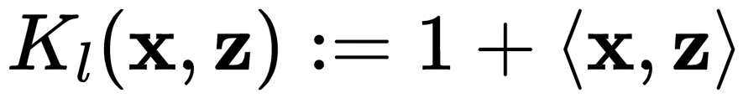
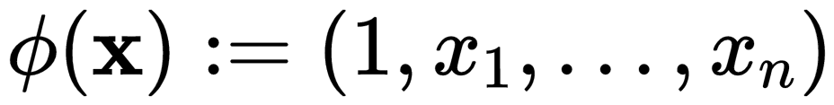
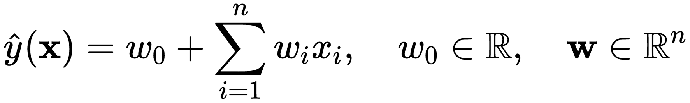
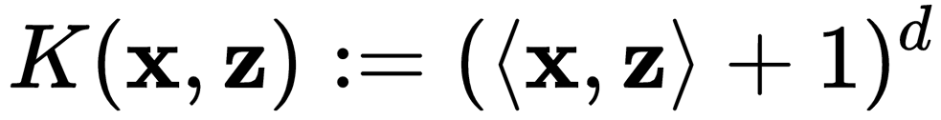
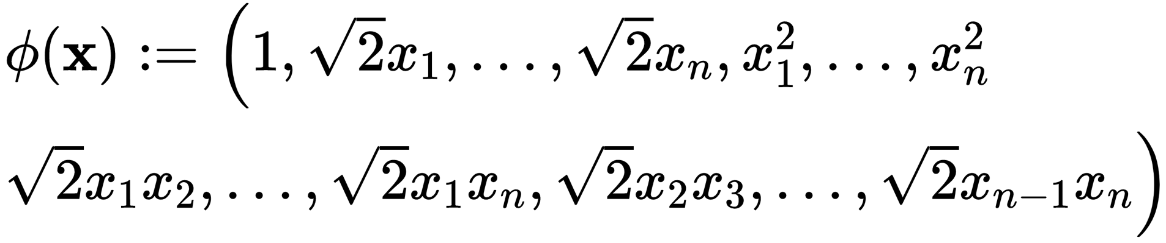
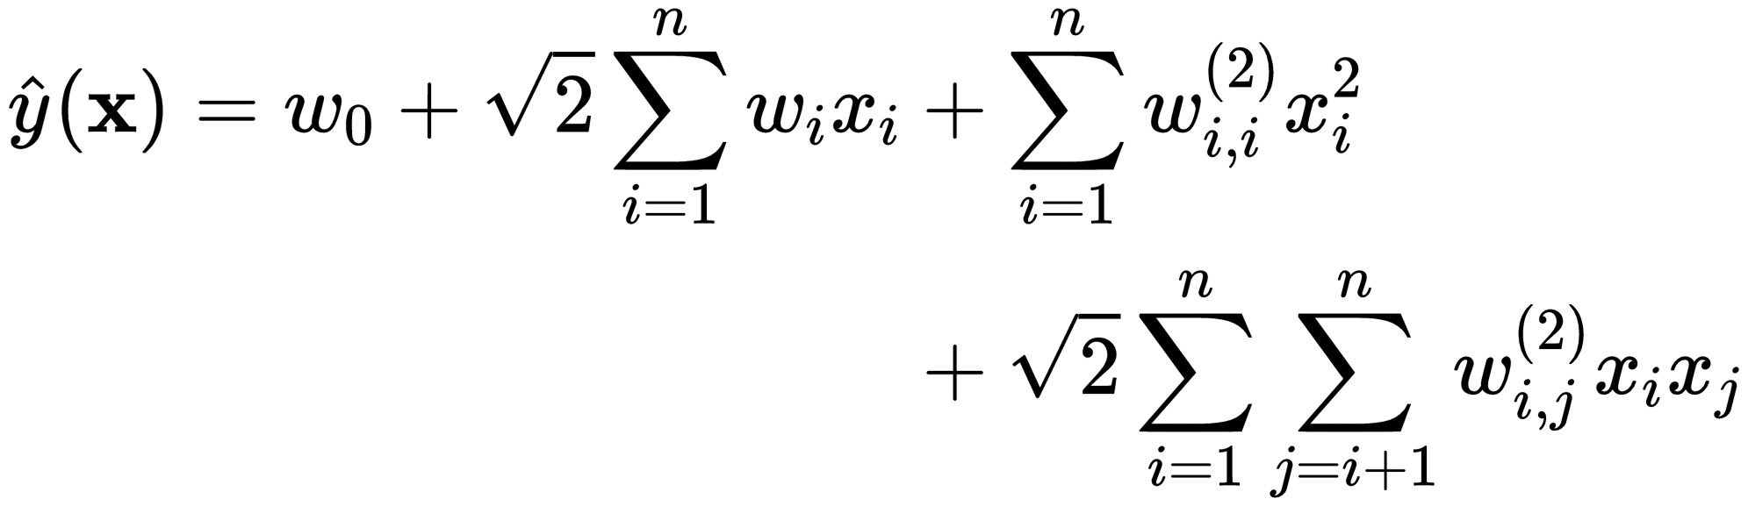
A. SVM model
1) Linear Kernel(identical to a FM of degree d = 1)
2) Polynomial Kernel

Slide 15
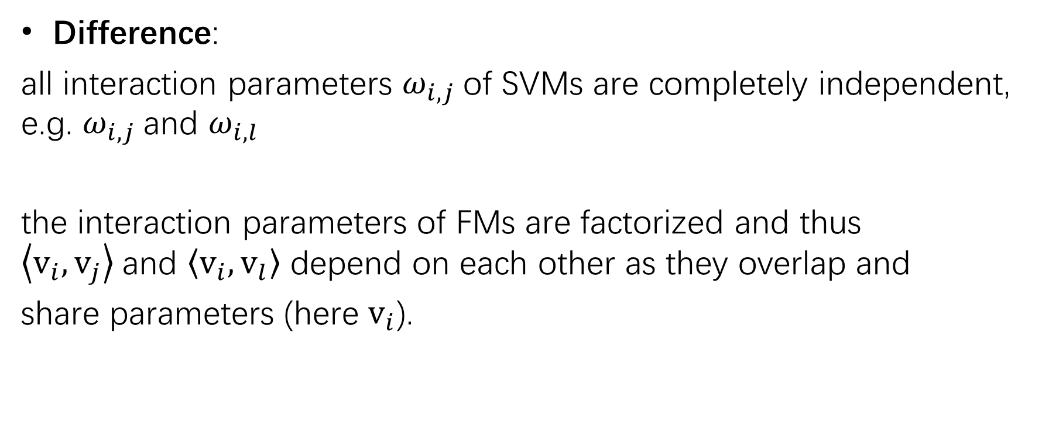
A. SVM model
Difference:
all interaction parameters $ω_{i,j}$of SVMs are completely independent, e.g. $ω_{i,j}$and $ω_{i,l}$
the interaction parameters of FMs are factorized and thus $\left\langle v_{i},v_{j}\right\rangle$and $\left\langle v_{i},v_{l}\right\rangle$ depend on each other as they overlap and
share parameters (here $v_{i}$).

Slide 16
B. Parameter Estimation Under Sparsity

Slide 17
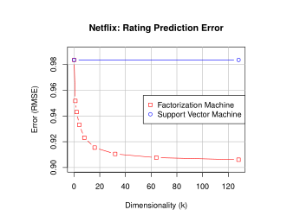
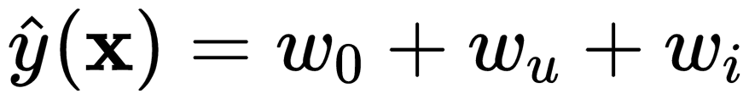
B. Parameter Estimation Under Sparsity
Linear SVM
Polynomial SVM

Slide 18
C. Summary
1) Parameters of FMs can be estimated well even under sparsity while SVMs fails.
2) FMs can be directly learned in the primal. Non-linear SVMs are usually learned in the dual.
3) The model equation of FMs is independent of the training data. Prediction with SVMs depends on parts of the training data (the support vectors).

Slide 19
FMS VS. OTHER FACTORIZATION MODELS

Slide 20
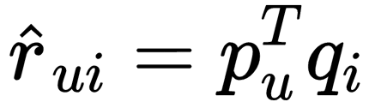
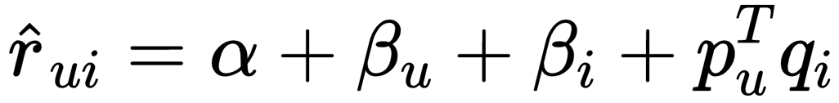
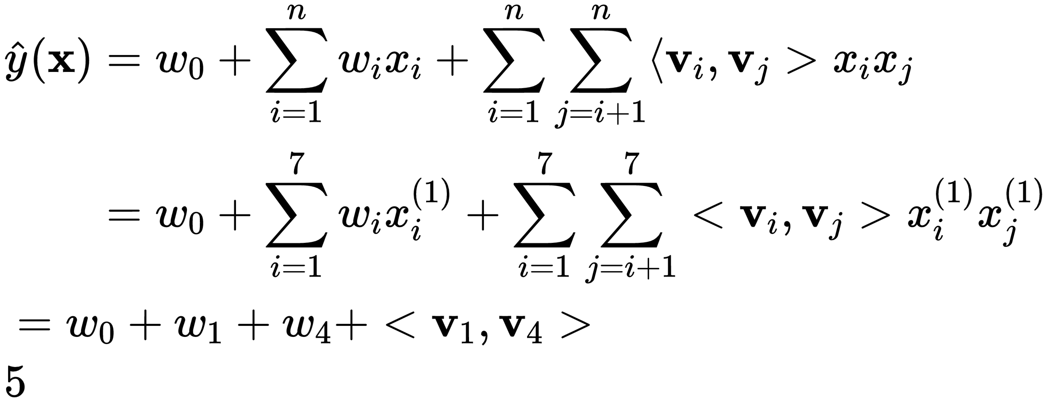
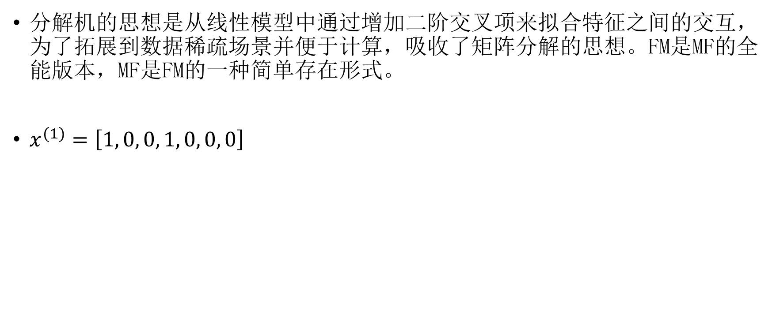
FM VS MF（Matrix Factorization）
分解机的思想是从线性模型中通过增加二阶交叉项来拟合特征之间的交互，为了拓展到数据稀疏场景并便于计算，吸收了矩阵分解的思想。FM是MF的全能版本，MF是FM的一种简单存在形式。
$x^{(1)}=\left[1, 0, 0, 1, 0, 0, 0\right]$

Slide 21
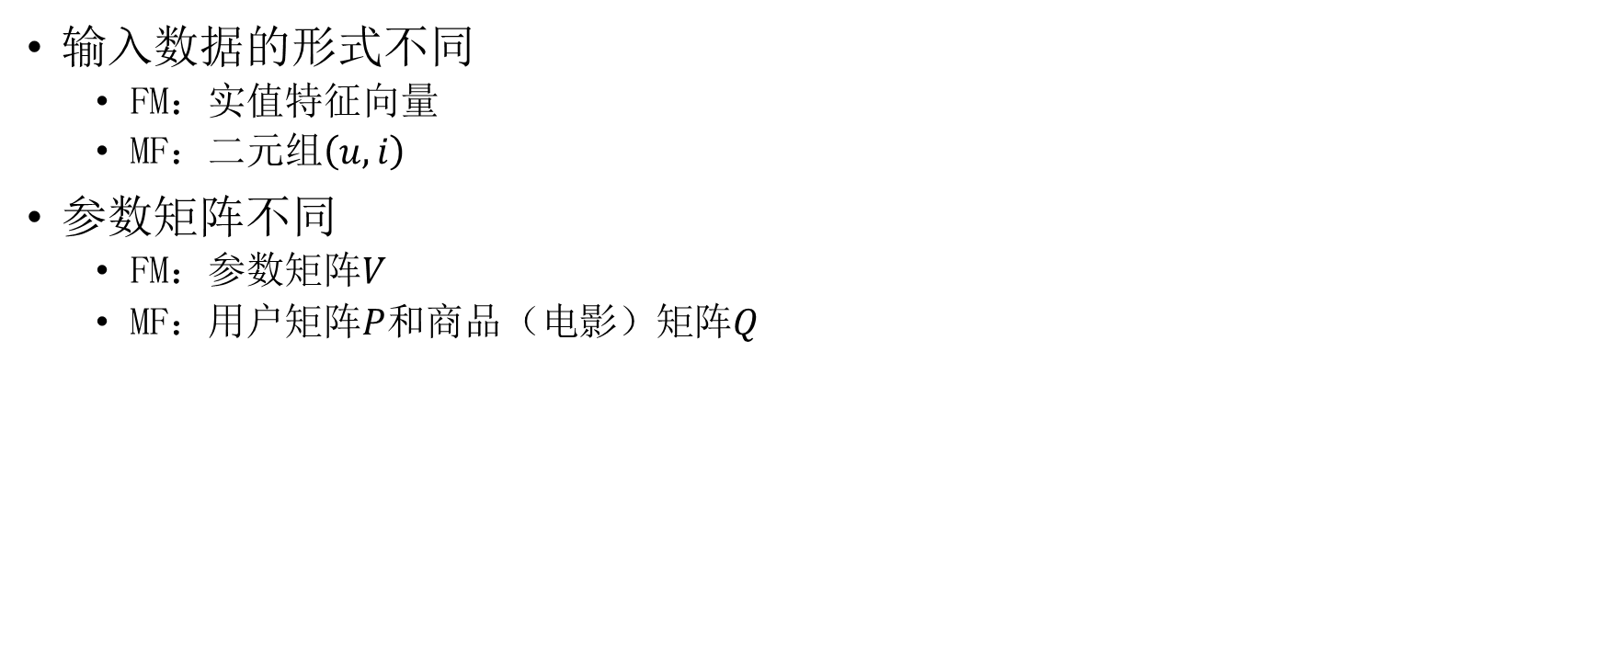
FM与MF的不同点
输入数据的形式不同
FM：实值特征向量
MF：二元组$\left(u, i\right)$
参数矩阵不同
FM：参数矩阵$V$
MF：用户矩阵$P$和商品（电影）矩阵$Q$

Slide 22
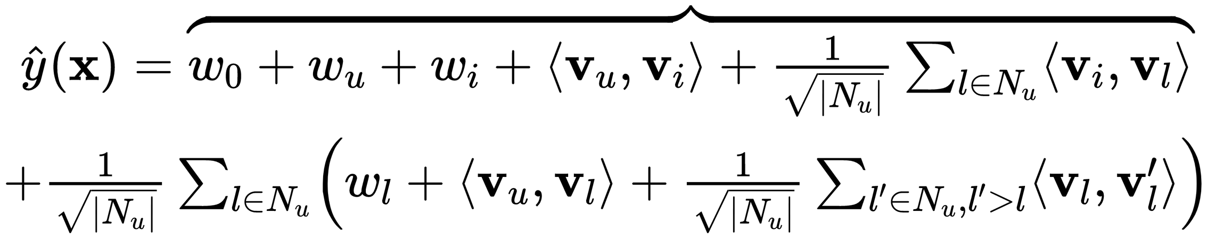
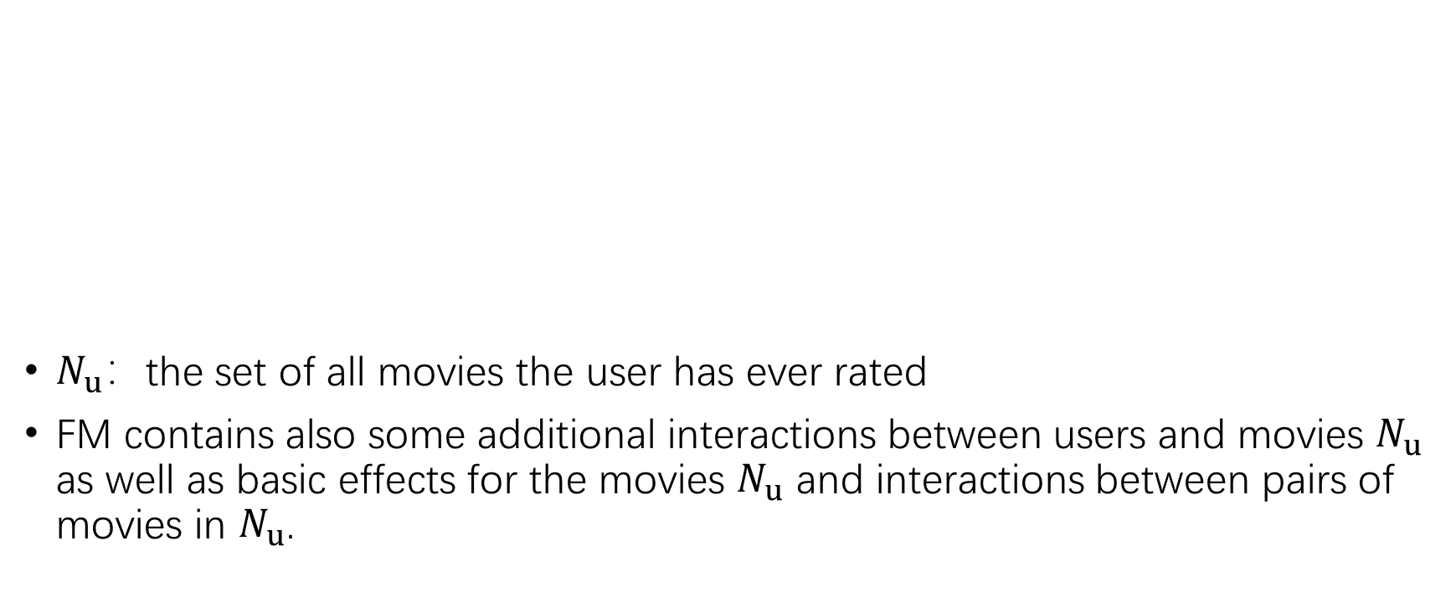
FM VS SVD++
SVD++
$N_{u}$：the set of all movies the user has ever rated
FM contains also some additional interactions between users and movies $N_{u}$ as well as basic effects for the movies $N_{u}$ and interactions between pairs of movies in $N_{u}$.

Slide 23
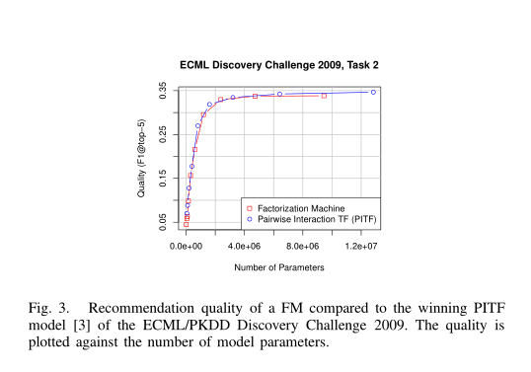
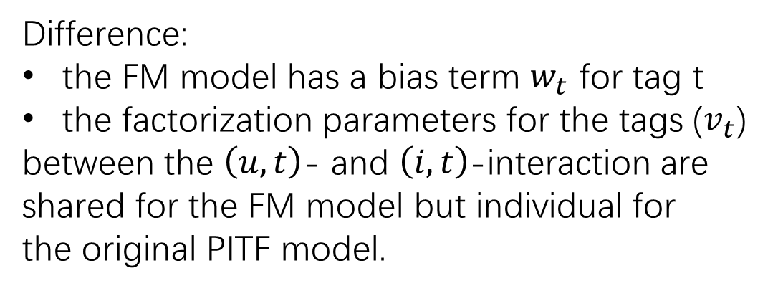
FM VS PITF
The problem of tag prediction is defined as ranking tags for a given user and item combination.
Difference:
the FM model has a bias term $w_{t}$ for tag t
the factorization parameters for the tags ($v_{t}$)
between the $\left(u, t\right)$- and $\left(i, t\right)$-interaction are
shared for the FM model but individual for
the original PITF model.

Slide 24
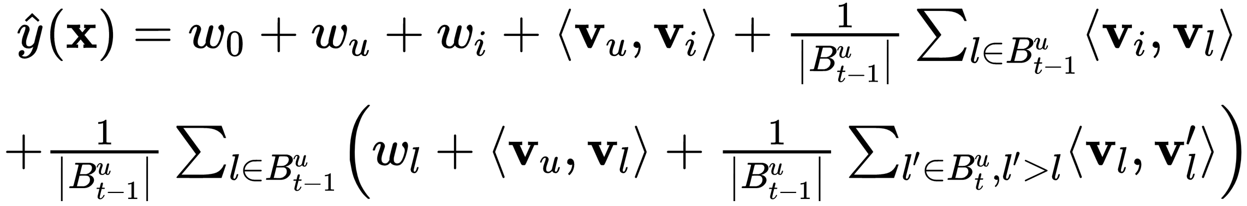
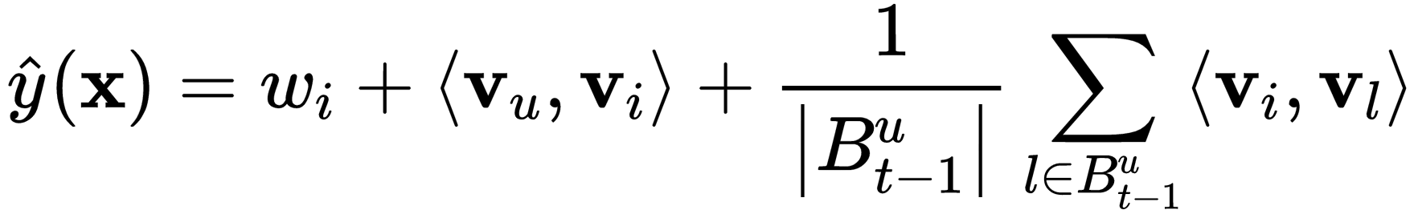
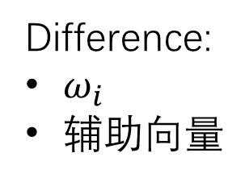
FM VS Factorized Personalized Markov Chains (FPMC)
The FPMC model tries to rank products in an online shop based on the last
purchases (at time t−1) of the user u.
Difference:
$ω_{i}$
辅助向量

Slide 25
Thanks!

